Slide 1


托福听力3
金牌听力名师
大菁儿老师
2021.6.4

Slide 2
第二节课回顾： 长对话部分的题型——重听题解题技巧 长对话部分的题型——功能题解题技巧 长对话部分的题型——推测题解题技巧 长对话部分的题型——推理题技巧 听力笔记方法、原则及笔记符号

Slide 3
对话场景词汇
长对话的综合练习及笔记训练
长演讲的分类、题型及解题技巧

Slide 4
场景词汇
图书馆与书店场景 Library & Book Store 各个区域
front desk [frʌnt] [dɛsk] 前台
circulation desk [,sɝkjə'leʃən] [dɛsk] 借还处
reference section ['rɛfrəns] ['sɛkʃən] 参考书区域，工具书区域
stack [stæk] n.书库，书堆
collection [kə'lɛkʃən] n.藏书，馆藏
video library ['vɪdɪo] ['laɪbrɛri] 录像图书馆
language lab ['læŋɡwɪdʒ] [læb] 语音室
archive ['ɑrkaɪv] n.档案馆
microfilm ['maɪkrofɪlm] n.微缩胶卷
check out [tʃɛk] [aʊt] 借
loan [lon] v.借; n.借贷物
return [rɪ'tɝn] v.还

Slide 5
场景词汇
renew [rɪ'nʊ] v.续借
extend [ɪk'stɛnd] v.延期
pick up [pɪk] [ʌp] 拿，取
request [rɪ'kwɛst] n.要求; v.请求
reserve [rɪ'zɝv] v.预定，预留
reshelf [rɪ'ʃɛlf] v.重新上架
recall ['rikɔl] v.召回
inter-library loan [ɪn'tə] ['laɪbrɛri] [lon] 馆际互借
loan period [lon] ['pɪrɪəd] 借书期限
due/overdue [du]/['ovɚ'dʊ] adj.到期的/逾期的
fine [faɪn] n.罚款
charge [tʃɑrdʒ] v.收钱，费用
borrowing privilege ['bɑroɪŋ] ['prɪvlɪdʒ] 借阅特权
rare book [rɛr] [bʊk] 珍藏本（书）
authorize ['ɔ:θəraiz] v.授权，批准

Slide 6
场景词汇
查找资料
search [sɝtʃ] v.搜索
research ['risɝtʃ] n.研究，调查
resource ['risɔrs] n.资源
source [sɔrs] n.来源；原始资料
material [mə'tɪrɪəl] n.材料
article ['ɑrtɪkl] n.文章
journal ['dʒɝnl] n.学术期刊
periodical [,pɪrɪ'ɑdɪkl] n.期刊
editorial [,ɛdɪ'tɔrɪəl] n.社论
gazette [gə'zɛt] n.公报，官报;时事报
literature ['lɪtrətʃɚ] n.文献
contemporary review [kən'tɛmpərɛri] [rɪ'vju] 当代评论
literature review ['lɪtrətʃɚ] [rɪ'vju] 文献综述
database ['detəbes] n.数据库
electronic version [ɪ,lɛk'trɑnɪk] ['vɝʒn] 电子版
printed version ['prɪntɪd] ['vɝʒn] 印刷版
key words [ki] [wɝdz] 关键词
abstract ['æbstrækt] n.摘要
summary ['sʌməri] n.摘要，概要

Slide 7
场景词汇
图书馆的辅助功能
print [prɪnt] v.打印
photocopy ['fotokɑpi] v.复印
scan [skæn] v.扫描
binding ['baɪndɪŋ] n.装订
internet
access/connection
['ɪntɚnɛt] ['æksɛs]
/[kə'nɛkʃən]

Slide 8
场景词汇
网络连接
plug in [plʌɡ] [ɪn] 插入（电源）
insert ['ɪnsɝt] v.插入（卡）
hook up to [hʊk] [ʌp] [tu] 连接到
student orientation ['studnt] [orɪɛn'teʃən] （新生）情况介绍
brochure [bro'ʃʊr] n.手册，宣传册
sign in [saɪn] [ɪn] 签到，登记
sign up [saɪn] [ʌp] 登记，报名
书店
merchandise ['mɝtʃəndaɪs] n.商品
purchase ['pɝtʃəs] v.买
textbook / coursebook ['tɛkstbʊk]/['kɔrsbʊk] n.教科书
exchange [ɪks'tʃendʒ] n./v.兑换
full refund [fʊl] [ˈrifʌnd] 全额退款
credit ['krɛdɪt] n.积分，钱
shipment ['ʃɪpmənt] n.货物
order ['ɔrdɚ] n.订单；v.订购
edition [ɪˈdɪʃən] n.版本
buyback ['baibæk] n.回购

Slide 9
练习：
TPO24-conversation1
Stephen Wolfram
in advance
back order 延期交货

Slide 10
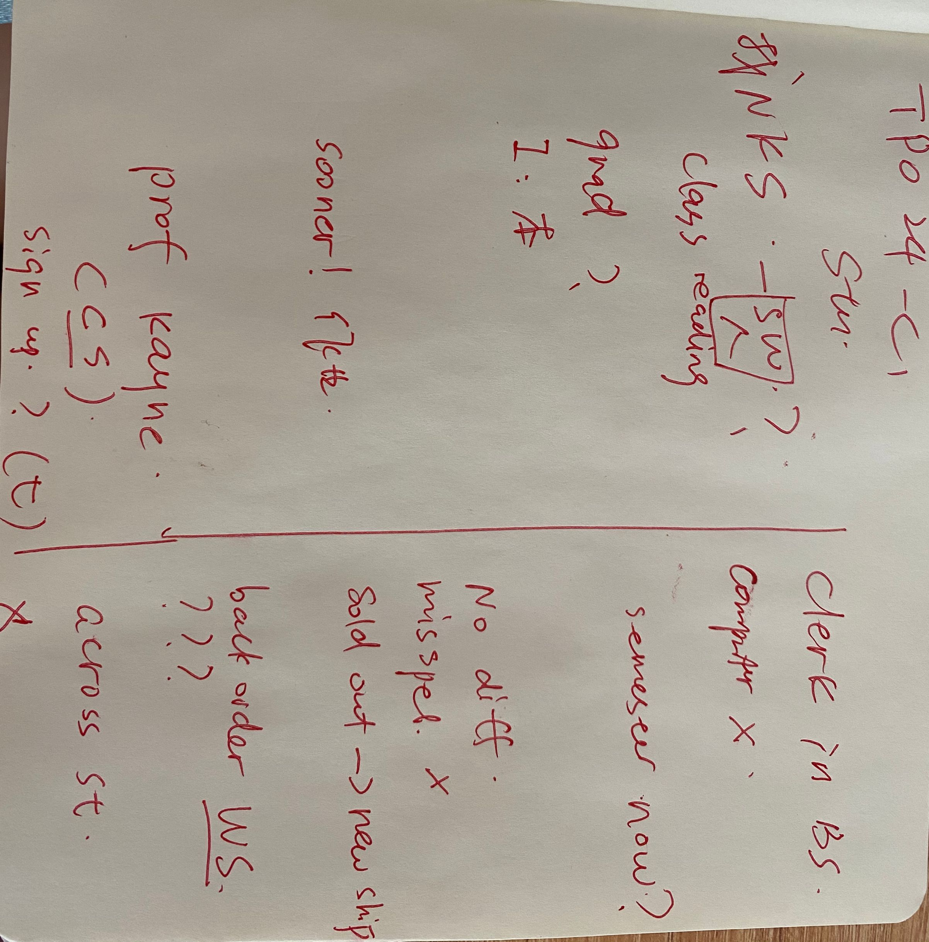
TPO24-conversation1
笔记

Slide 11
TPO24-conversation1
1.Why can the man NOT find the book he needs?
A. The bookstore is sold out of the book.
B. The bookstore he is in does not carry the book.
C. His professor did not order enough copies of the book.
D. The book is not being used for any course offered at the university.

Slide 12
TPO24-conversation1
2.What are two possible reasons that the speakers consider for why the man cannot find the book?
A. It is for a graduate-level course.
B. Information about the book was entered incorrectly into the computer system.
C. The man has given the woman an incorrect title for the book.
D. The professor forgot to submit the book order.

Slide 13
TPO24-conversation1
3.What does the woman offer to do for the student?
A. Save a copy of the book for him as soon as it comes in.
B. Order more copies of the book.
C. Call the computer store across the street.
D. Find a store that sells the book if he cannot find it.

Slide 14
TPO24-conversation1
4.How does the man react to the information the woman gives him about where computer science books are sold?
A. He is embarrassed that he did not think of it himself.
B. He suggests that the information be posted in the store.
C. He apologizes for bothering the woman.
D. He is annoyed that the woman did not tell him sooner.

Slide 15
TPO24-conversation1
5.Why does the woman say this？
A. To determine how urgent the student s need is.
B. To figure out why the book is not listed on the computer.
C. To find out what level computer science course the man is taking.
D. To explain why the book might be sold out.

Slide 16
TPO24-conversation1
1.Why can the man NOT find the book he needs?
A. The bookstore is sold out of the book.
B. The bookstore he is in does not carry the book.
C. His professor did not order enough copies of the book.
D. The book is not being used for any course offered at the university.

Slide 17
场景词汇
各类论文
essay ['ɛse] n.论文
assignment [ə'saɪnmənt] n.作业
synopsis [sɪ'nɑpsɪs] n.(小说、电影、剧本等的)
梗概，概要，大纲
review [rɪ'vju] n.评论；综述
term paper [tɝm]['pepɚ] 学期论文
thesis ['θisɪs] n.论文
dissertation ['dɪsɚ'teʃən] n.（学位）论文 或修改
preliminary research [prɪ'lɪmɪnɛri]['risɝtʃ] 初步研究
scope [skop] n.范围
proposal [prə'pozl] n.开题报告
design plan [dɪ'zaɪn][plæn] 设计方案
background knowledge ['bækɡraʊnd]['nɑlɪdʒ] 背景知识
perspective [pɚ'spɛktɪv] n.观点，视角
main argument [men]['ɑrɡjumənt] 主论点
outline ['aʊtlaɪn] n.提纲
draw up [drɔ][ʌp] 得出（结论）
revise [rɪ'vaɪz] v.修改
rewrite ['riraɪt] v.重写

Slide 18
场景词汇
各类论文
clarify ['klærəfaɪ] v.澄清；阐明
tangential [tæn'dʒɛnʃl] adj.离题的
wander off topic ['wɑndɚ] [ɔf] ['tɑpɪk] 跑题
structure ['strʌktʃə] n.结构
comment ['kɑmɛnt] n.评论
format ['fɔrmæt] n.格式
cover ['kʌvɚ] v.包括；覆盖
title ['taɪtl] n.标题
acknowledgement [ək'nɑlɪdʒmənt] n.鸣谢，声明
abstract ['æbstrækt] n.摘要
index ['ɪndɛks] n.索引

Slide 19
场景词汇
各类论文
catalog/content ['kætəlɔg]/ ['kɑntɛnt] n.目录
introduction [,ɪntrə'dʌkʃən] n.引言
literature review ['lɪtrətʃɚ] [rɪ'vju] 文献综述
the body of the paper - 正文部分
discussion [dɪ'skʌʃən] n.讨论
conclusion [kən'kluʒn] n.结论
bibliography [,bɪblɪ'ɑɡrəfi] n.参考书目
citation [saɪ'teʃən] n.引用
reference section ['rɛfrəns]['sɛkʃən] 参考书目部分
appendix [ə'pɛndɪks] n.附录
figure/chart/graph/table ['fɪɡjɚ]/[tʃɑrt]/[ɡræf]/['tebl] n.图表/表格
diagram ['daɪəɡræm] n.图表，图解，示意图; v.画

Slide 20
练习：
TPO2-conversation1
casual knowledge基本知识
rule of thumb 经验法则
jot down快速记下
meteorological records气象记录
reference section参考书目

Slide 21
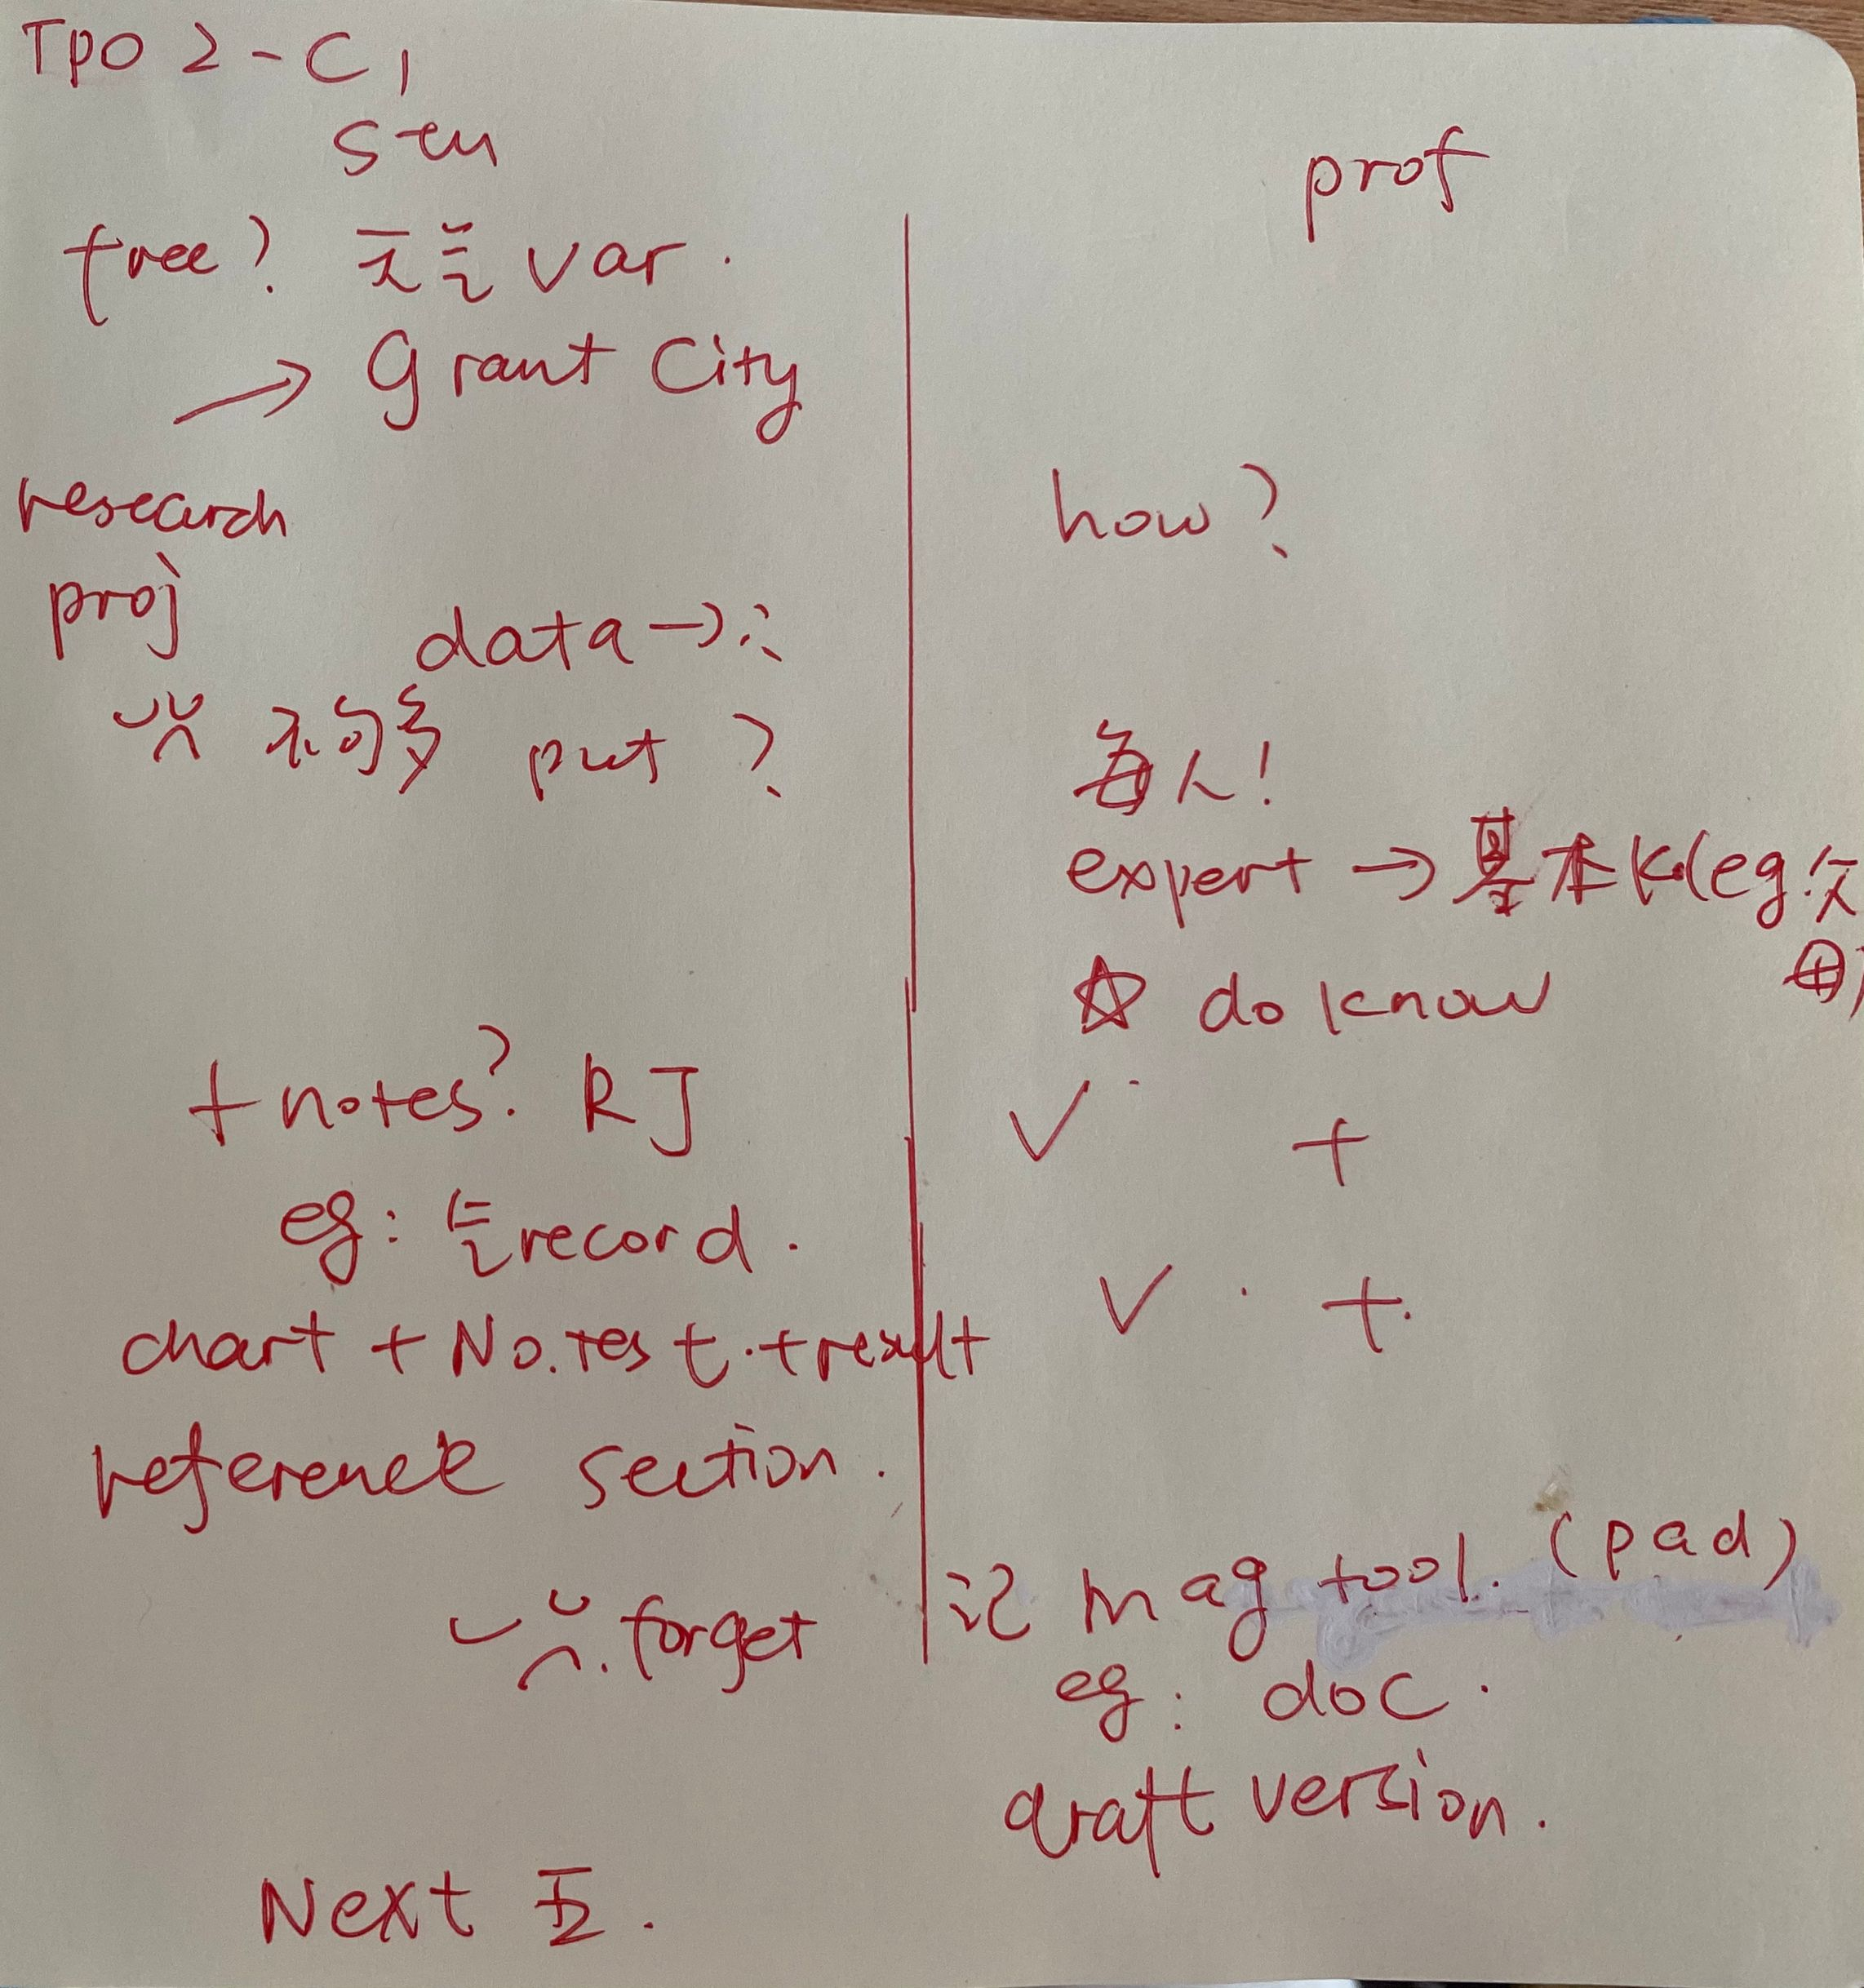
TPO2-conversation1
笔记

Slide 22
TPO2-conversation1
1.Why does the man go to see his professor?
a) To borrow some charts and graphs from her
b) To ask her to explain some statistical procedures
c) To talk about report he is writing
d) To discuss a grade he got on a paper

Slide 23
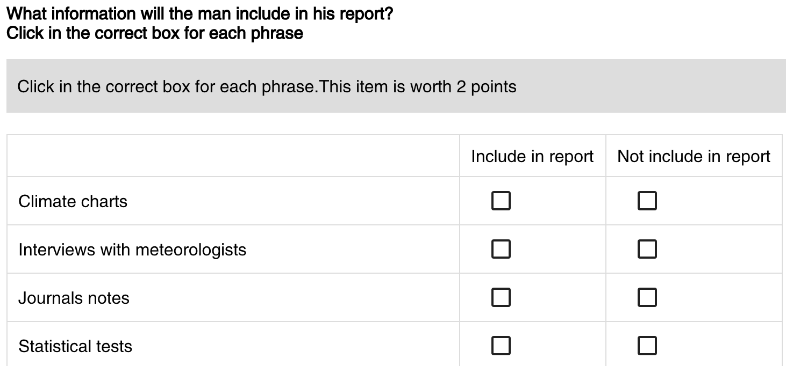
TPO2-conversation1

Slide 24
TPO2-conversation1
3.Why does the professor tell the man about the appointment at the doctor's office?
a) To demonstrate a way of remembering things
b) To explain why she needs to leave soon
c) To illustrate a point that appears in his report
d) To emphasize the importance of good health

Slide 25
TPO2-conversation1
4.What does the professor offer to do for the man?
a) Help him collect more data in other areas of the state
b) Submit his research findings for publication
c) Give him the doctor's telephone number
d) Review the first version of his report

Slide 26
TPO2-conversation1
5.Why does the professor say this?
a) To question the length of the paper
b) To offer encouragement
c) To dispute the data sources
d) To explain a theory

Slide 27
场景词汇
工作：
work-study ['wɝk, stʌdi] adj.半工半读的
part-time [,pɑrt'taɪm] n.兼职
full-time [,fʊl'taɪm] n.全职
internship ['ɪntɝnʃɪp] n.实习
求职：
on/off campus - ['kæmpəs] 校内/校外
position [pə'zɪʃ(ə)n] n.职位
replacement [rɪ'plesmənt] n.代替者；复职
vacancy ['vekənsɪ] n.空缺
recruit [rɪ'kruːt] v.招募，招聘
hire ['haɪɚ] v.雇用
career fair [kə'rɪr] [fɛr] n.招聘会
representative ['rɛprɪ'zɛntətɪv] n.代表；代理人
reference ['rɛfrəns] n.推荐信，证明文件；介绍人，推荐人
resumé [rɛzəˌme] n.简历

Slide 28
场景词汇
interview ['ɪntəvjuː] n.面试
apply [ə'plaɪ] v.申请
try out - 考验；试用；选拔
candidate [ˈkændɪˌdet, -dɪt] n.候选人；应试者
career [kə'rɪə] n.职业
opportunity [ɒpə'tjuːnɪtɪ] n.机会
workshop ['wɝkʃɒp] n.研习班
suit [suːt] n.西装
salary ['sælərɪ] n.工资(脑力工作者)
wage [wedʒ] n.工资(体力工作者)
rate [ret] n.（级别）工资
paycheck ['pe,tʃɛk] n.工资（支付薪水的支票）
payroll ['perol] n.工资单
work experience [wɝk] [ɪk'spɪrɪəns] n.工作经验
advancement [əd'vænsmənt] n.晋升
promote [prə'mot] v.升职
commute [kə'mjʊt] v./n.通勤

Slide 29
场景词汇
manager ['mænɪdʒə] n.经理
employer [ɪm'plɒɪə; em-] n.雇主
employee [emplɒɪ'iː] n.雇员
staff [stæf] n.职员，工作人员
supervisor ['supɚvaɪzɚ] n.监督人；主管
director [dɪˈrɛktɚ] n.主任，主管；导演
assistant [ə'sistənt] n.助理
volunteer [,vɑlən'tɪr] n.志愿者

Slide 30
练习：
TPO35-conversation1
counselor
Visualization Project
dynamic map
Mediterranean
flexible

Slide 31
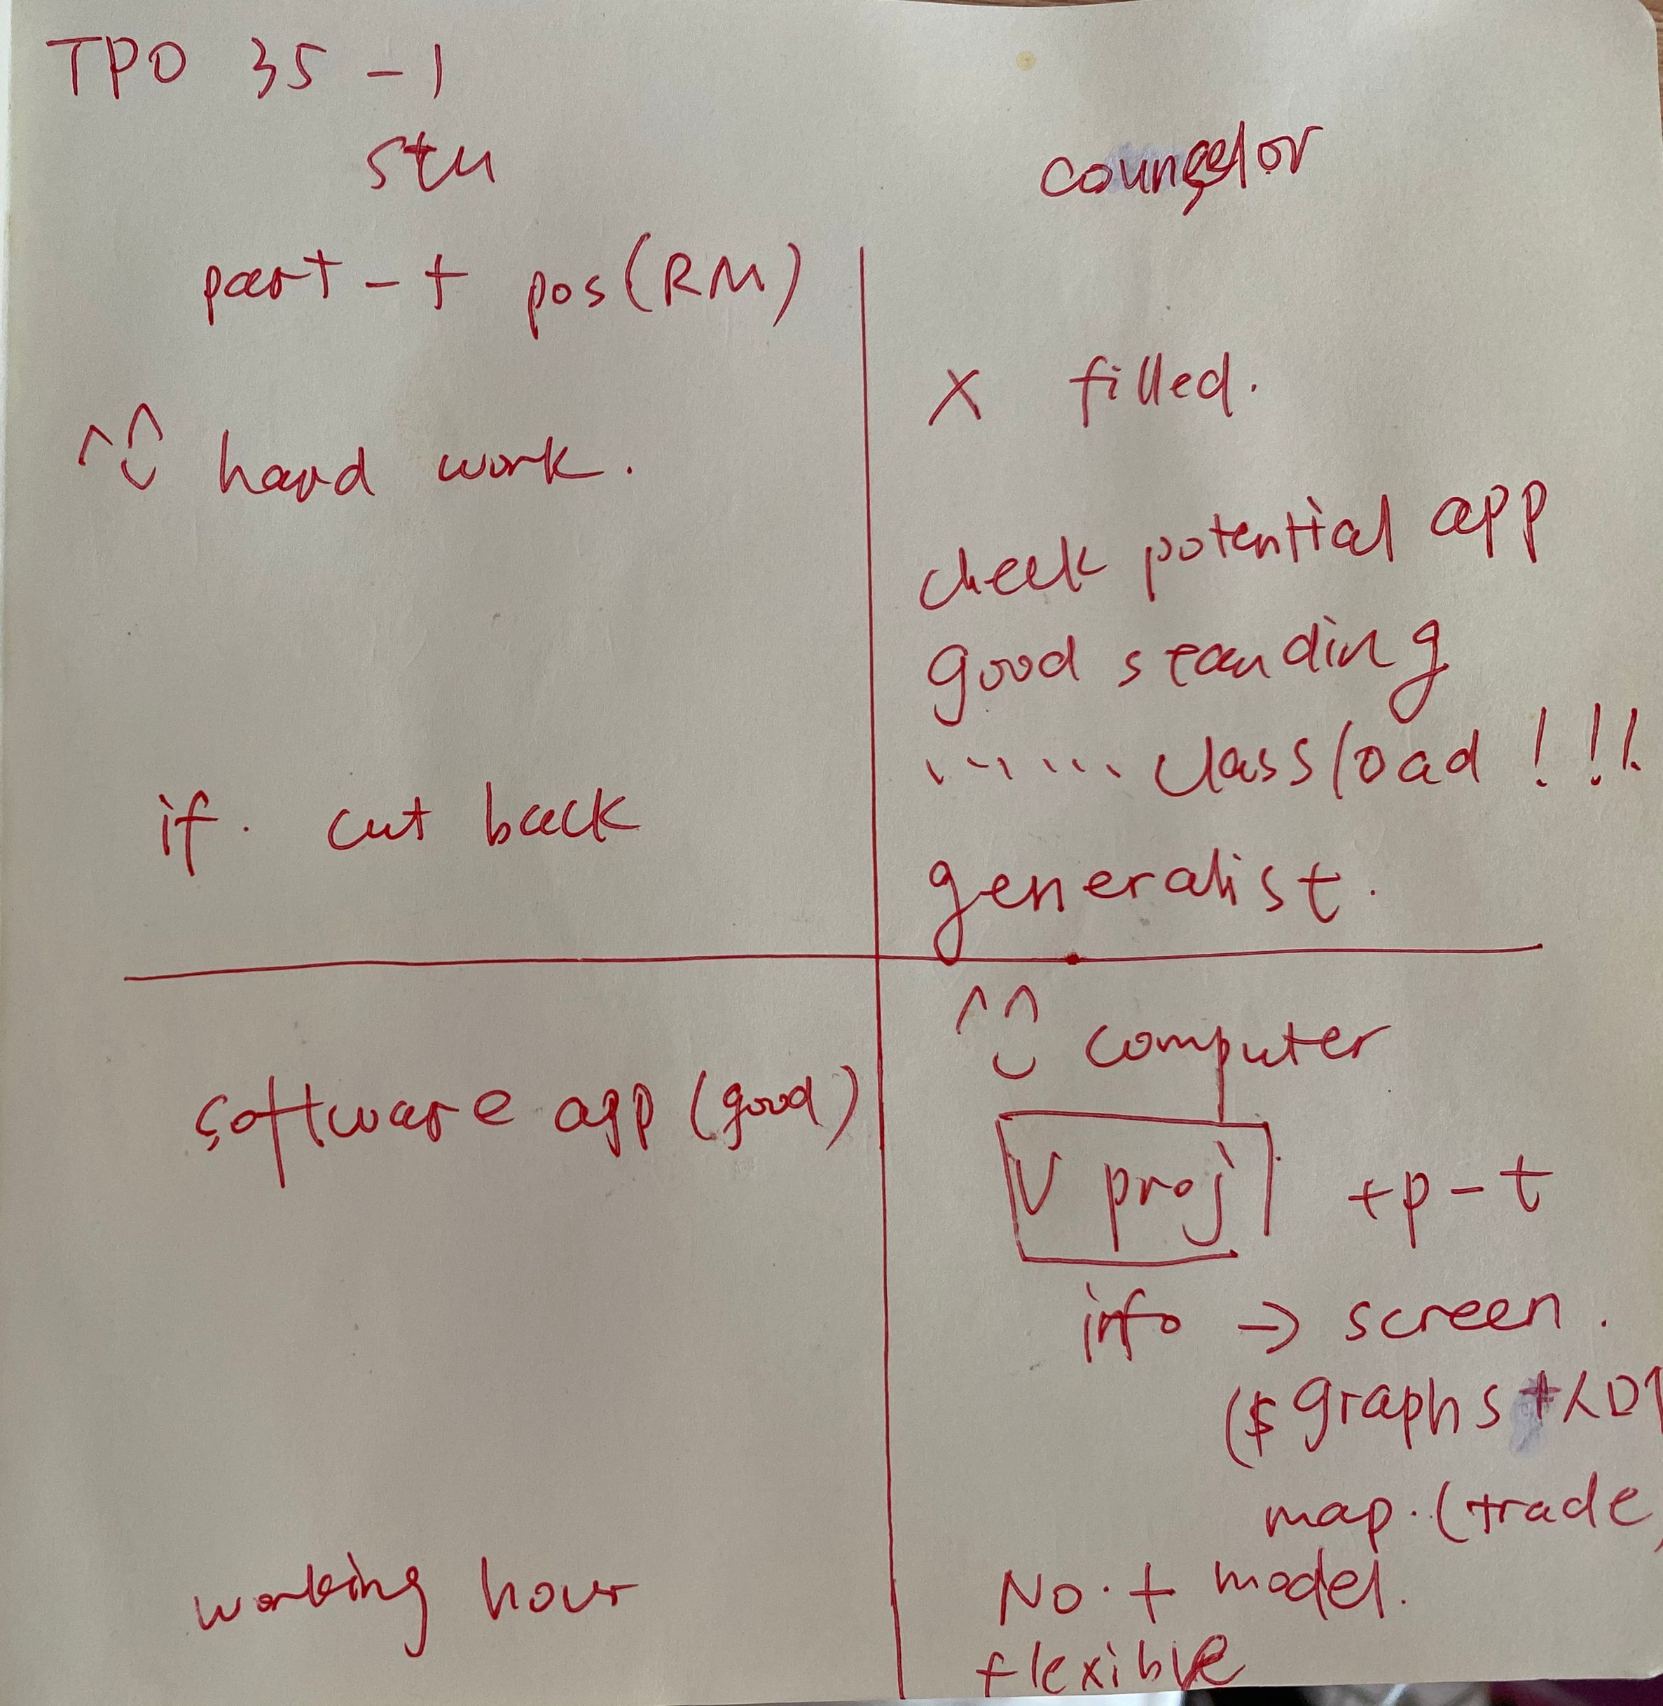
TPO35-conversation1
笔记

Slide 32
TPO35-conversation1
1.What is the conversation mainly about?
A. The woman’s schedule of classes for the coming semester.
B. A job possibility in the dining hall.
C. The woman’s need to specialize in a particular subject.
D. Work involving the use of computer application.

Slide 33
TPO35-conversation1
2.What does the man imply about some professors?
A. They have difficulty with some computer technology.
B. They spend more time on research than on teaching.
C. They often understand an idea better after presenting it to students.
D. They often have their students give class presentations.

Slide 34
TPO35-conversation1
3.What does the Visualization Project provide to professors? Click on 2 answers
A. Recordings of their lectures for viewing by students in distant locations.
B. Presentations of data in ways that may give new insights into current research.
C. Specially made graphs, maps, and other on-screen aids for classrooms use.
D. Training in the use of computer software that shares data between academic departments.

Slide 35
TPO35-conversation1
4.What does the woman learn about staff members for Visualization Project? Click on 2 answers.
A. They deal with information on a wide variety of academic topics.
B. They often have to go to professors' offices to help.
C. They work at times of their own choosing.
D. They come from many different parts of the world.

Slide 36
TPO35-conversation1
5.What does the man mean when he says this:
A. He doubts the woman's claim.
B. He agrees with what the woman says.
C. He needs to know more about the woman's class schedule.
D. He cannot evaluate the woman's qualifications.

Slide 37
长演讲的分类、题型及解题技巧
分类：对真实大学课堂教授教学和学生课堂讨论的真实还原，涉及题材广泛，
高频常考类型有社会科学、自然科学、生命科学和文化艺术类。
社会科学类主要包括考古学、心理学、社会学、经济学、历史学、教育学、人类学等。
自然科学类主要包括地理学、天文学、环境科学、化学、生态学、物理学等。
生命科学类主要包括生物学、动物学、植物学等
艺术类主要涉及文学、建筑、艺术绘画、摄影、雕塑等题材

Slide 38
1. 主旨题
What is the main idea of this lecture?
文章的开头直接给出；上节课➕本节课；重复；
新旧理论；专有名词；总结词；细节是错误选项

Slide 39
2. 细节题：
What does the word “anthropologist" mean? According to the passage, What is the most significant event in 2.000 B.C.?
Why does the critic dislike the ancient style of sculpture?
把握信号词，如因果的accordingly，thus，列举、相似或对比、转折、强调、总结、定义、建议、数字。

Slide 40
3. 态度题：
What is the professor’s attitude toward......？
通过语气、语调、重读来推测
演讲中比较学术，通过形容词和副词的褒贬色彩来确定说话者的意图。
正确选项不是直接表述。

Slide 41
4. 推断题：
What does the woman imply about the new medical research?
What can we infer from the professor’s comment on the New England system?
推断须基于原文，着重听语气，其实考察细节，选择主旨相关内容

Slide 42
5. 重听题：
Listen again to part of the lecture, then answer the question.
What does the professor mean when she says this?
说话人的语气加强时、有人提问、文章结构转折处
结合重复的内容在录音材料中的上下文去推理才能得出答案

Slide 43
组织结构题：
What is the organization of this passage?
How is the lecture organized?
What method does the professor use to develop his idea?
考得很少但让人头疼
文章的组织结构，记录逻辑展开的框架

Slide 44
内容连接题：
what’s the likely outcome of doing procedure X before procedure Y?
记笔记的能力，注意听顺序性的词
没有顺序性词提示，词汇含义、逻辑关系如因果、转折、强调、比较进行梳理。
会结合细节考查。

Slide 45
配对表格题：
In the lecture, the professor discusses characteristics of folktales and fairy tales, indicate the characteristics of each type of the tale...Click in the correct boxes. This question is worth two points.
信息对号入座 混偏反无一定不能选
文章中会出现两个人或物，对它们多方面进行比较与对比。
在听文章时，要对对是否可能会出现表格题进行预判，掌握先机。

Slide 46
课后作业：
1. 回顾本次课内容，完成所有单词记忆内容
2. 完成TPO35-40的所有conversation题目
3. 预习第四次课中十大考点（见讲义）
题目群里打卡

Slide 47
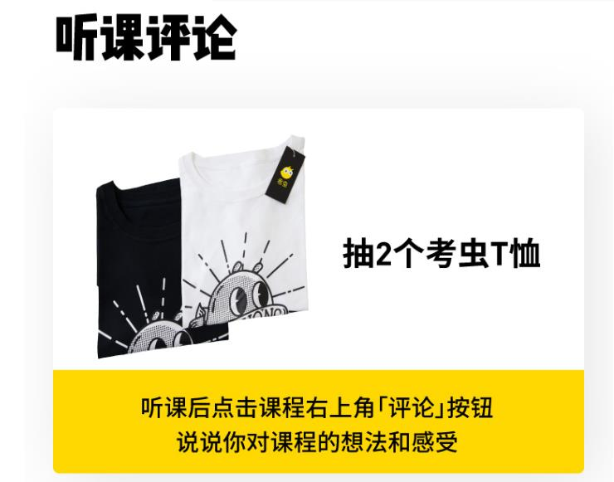
【✨课程福利✨】
1. 微博打卡：#考虫托福系统班#+天数+收获+图片+@考虫托福 @相应科目的老师 @酵母菁
（1）每周一抽取2个上周连续打卡的虫子送抱枕
2. 听课评论，听课后点击右上角【评论】按钮，说说虫子们对课程的想法和感受，课程结束后抽2个考虫T恤喔！

Slide 48
综合练习：
TPO43-C2

Slide 49
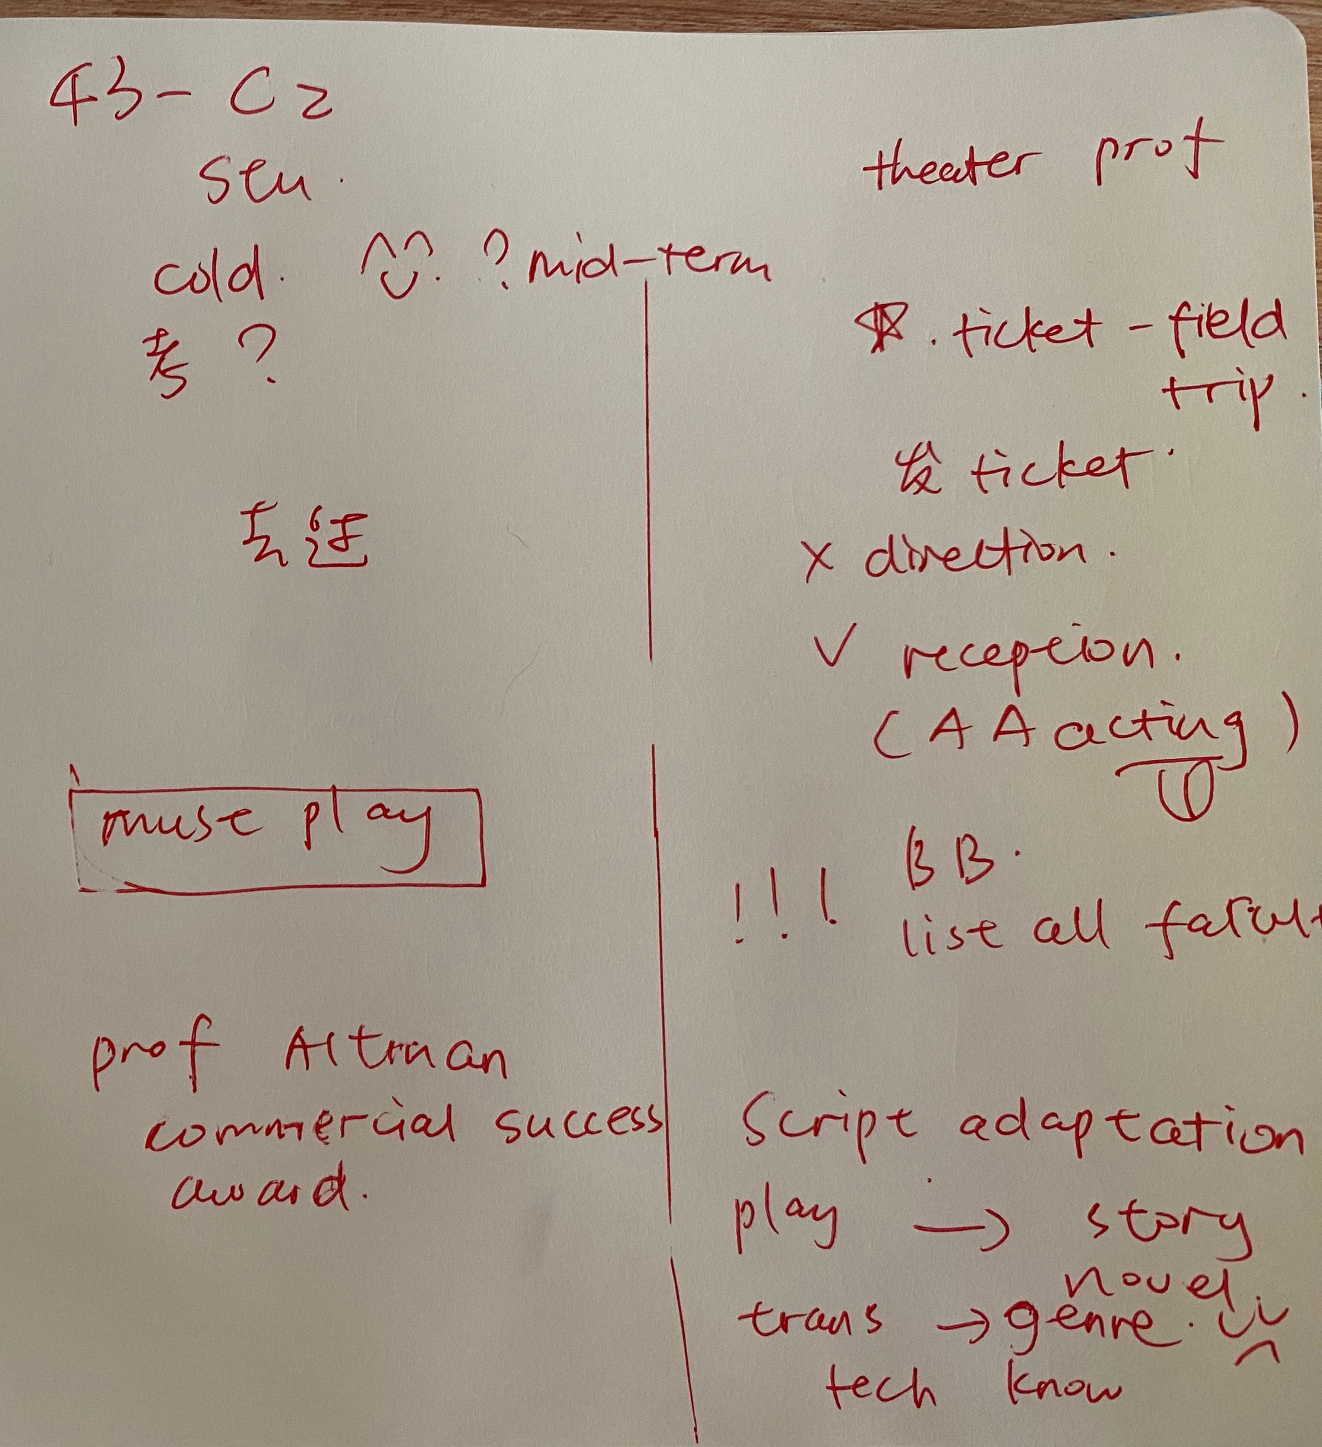
综合练习：
TPO43-C2

Slide 50
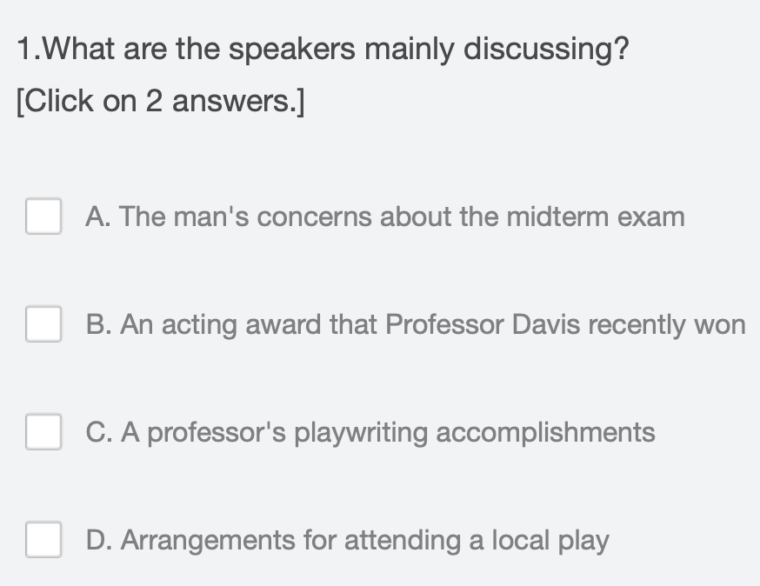
综合练习：
TPO43-C2

Slide 51
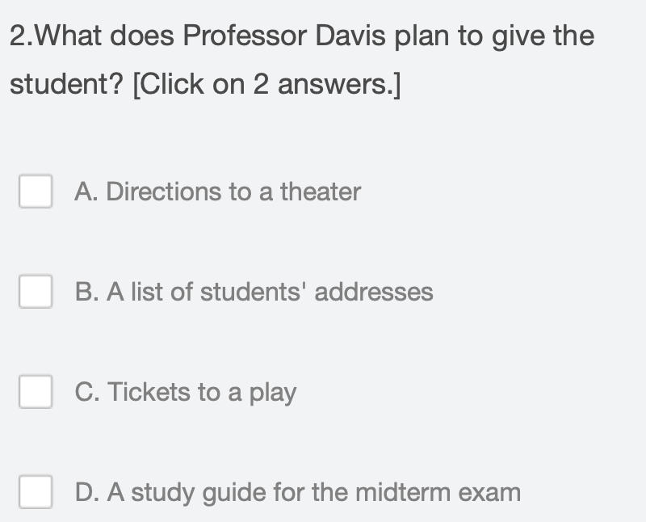
综合练习：
TPO43-C2

Slide 52
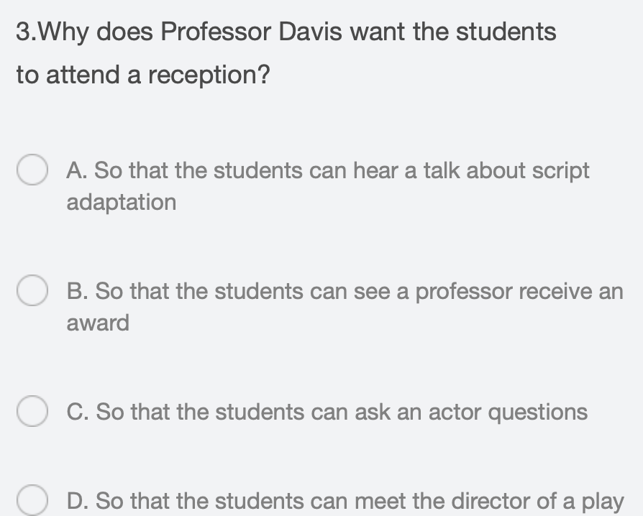
综合练习：
TPO43-C2

Slide 53
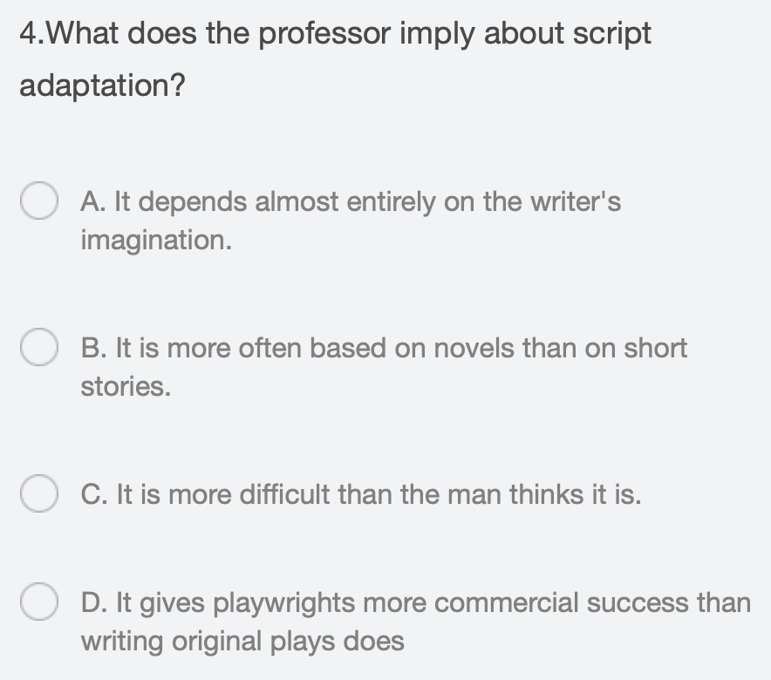
综合练习：
TPO43-C2

Slide 54
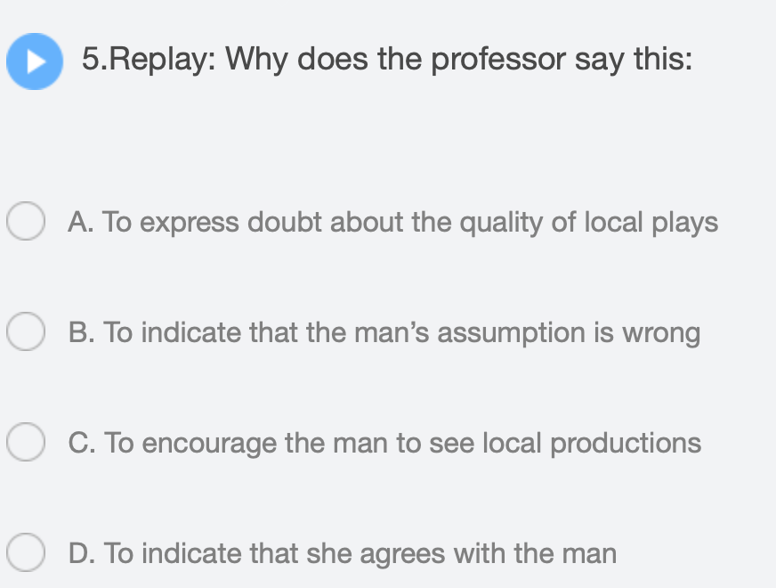
综合练习：
TPO43-C2

Slide 55
End

